Slide 1
How to Deploy Static Website Hosting Through S3 bucket Using AWS CCI

Slide 2
Amazon Simple Storage Service (Amazon S3) or Amazon S3 is an object type, high-speed or with minimal latency, low-cost and scalable storage service provided by AWS.
S3 also allows you to store as many objects as you’d like with an individual object size limit of five terabytes.
It provides 99.999999999 (11 ‘9’s) percent durability and 99.99 percent availability of the objects which reside in it.
In this article, you will create your first bucket in Amazon S3.

Slide 3
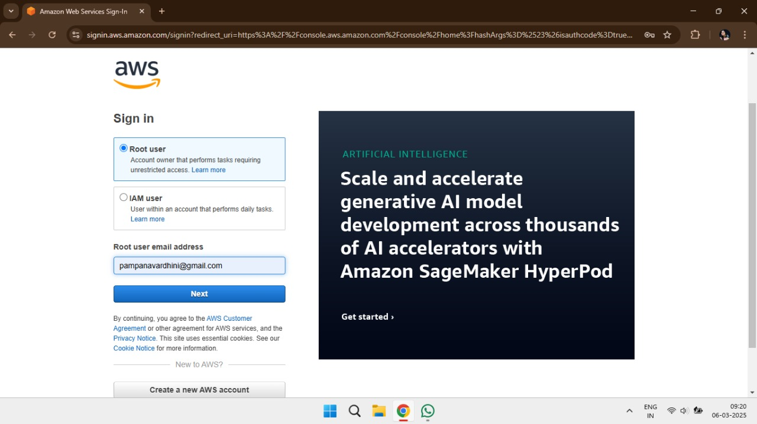
Follow these steps to create a bucket in your Amazon Simple Storage Service:
Step-1: Log on to your AWS Console. If you don’t have an
account, you can create it absolutely free as Amazon provides a 1-year free tier to its new users.

Slide 4
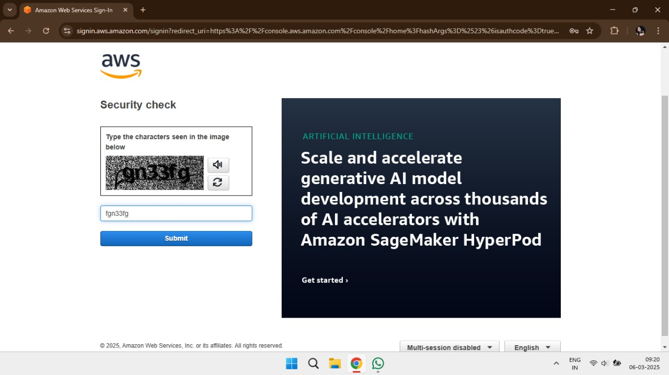
Step-2: Enter the Captcha

Slide 5
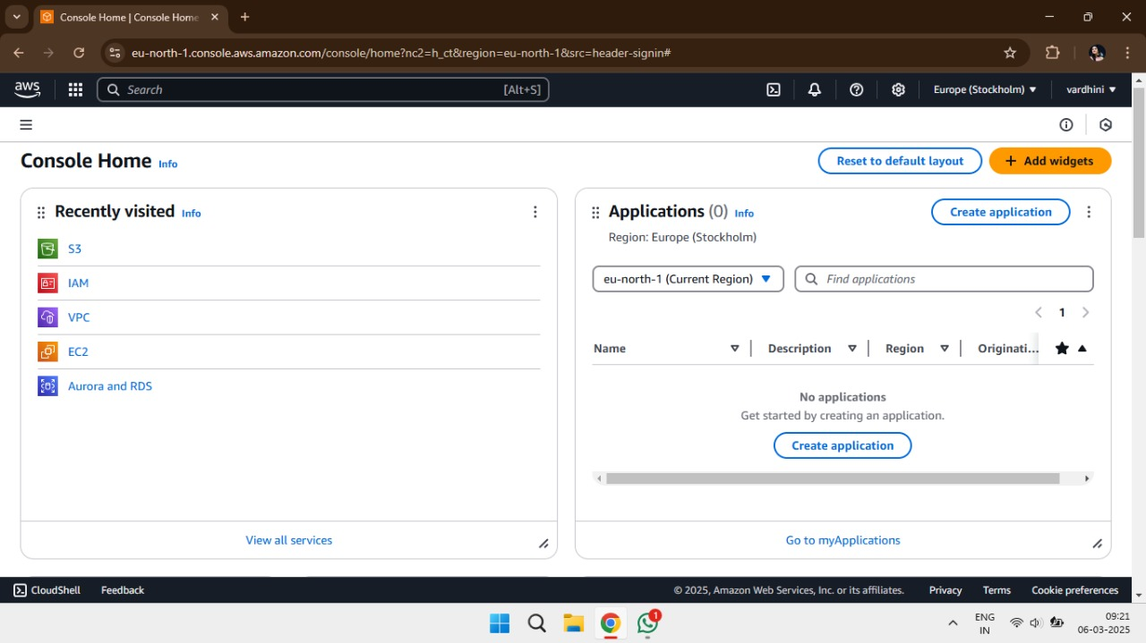
Step-3: Type S3 Bucket in command bar

Slide 6
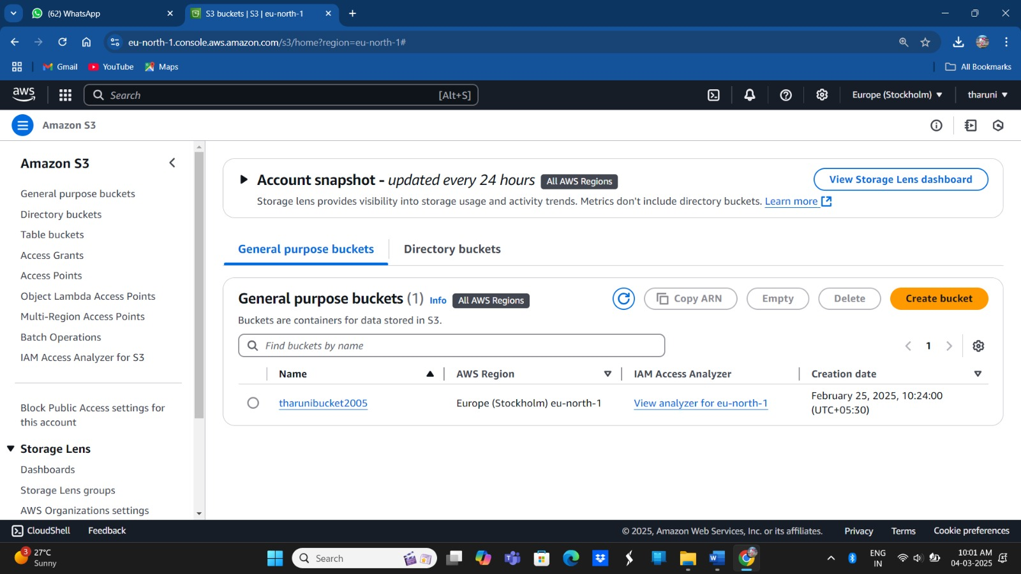
Step-4: Create Bucket and provide some credentials to it

Slide 7
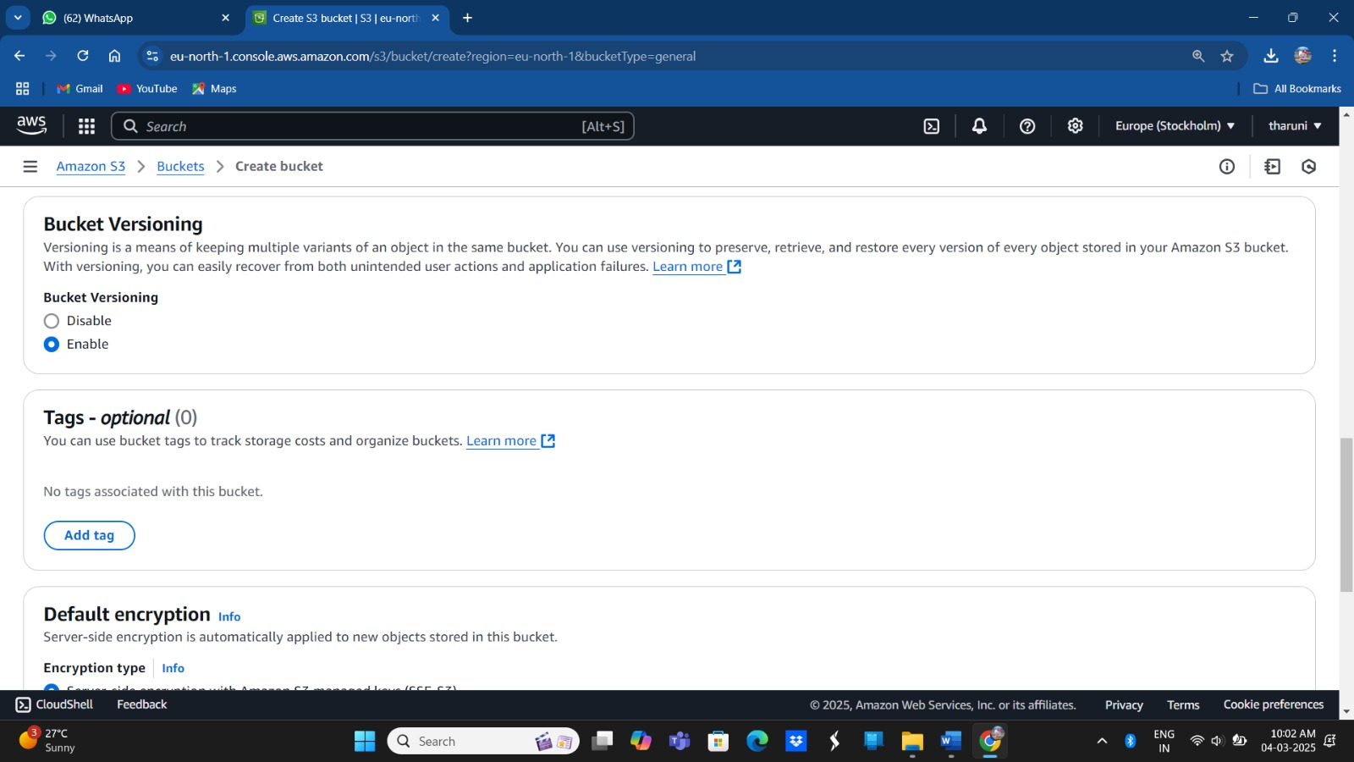
Step-5: Allow the Permissions to deploy a static website

Slide 8
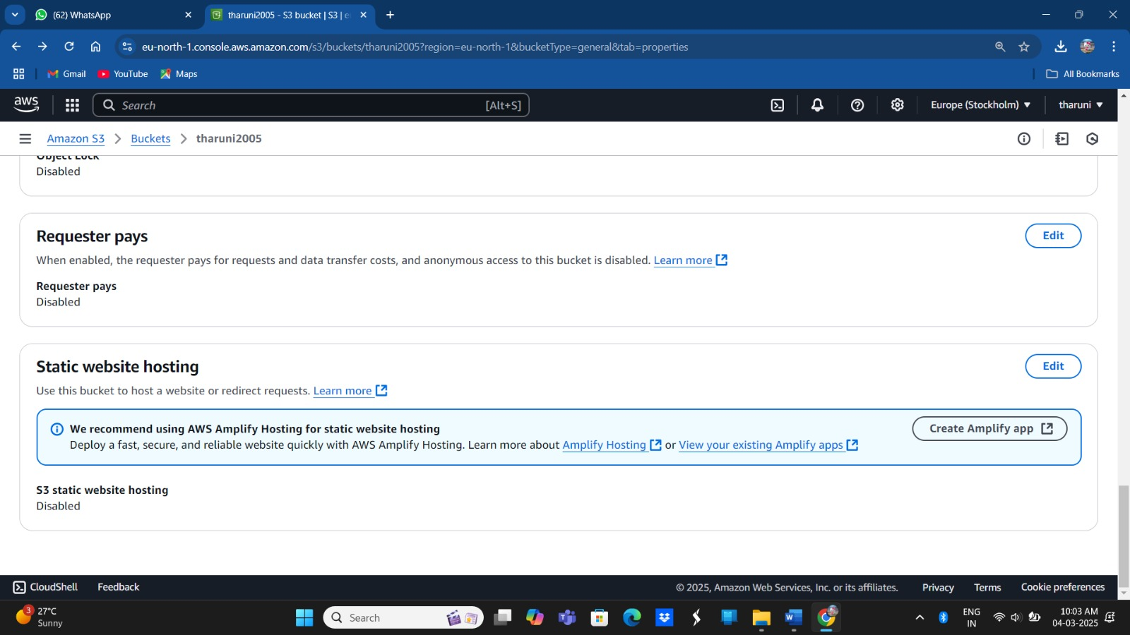

Slide 9
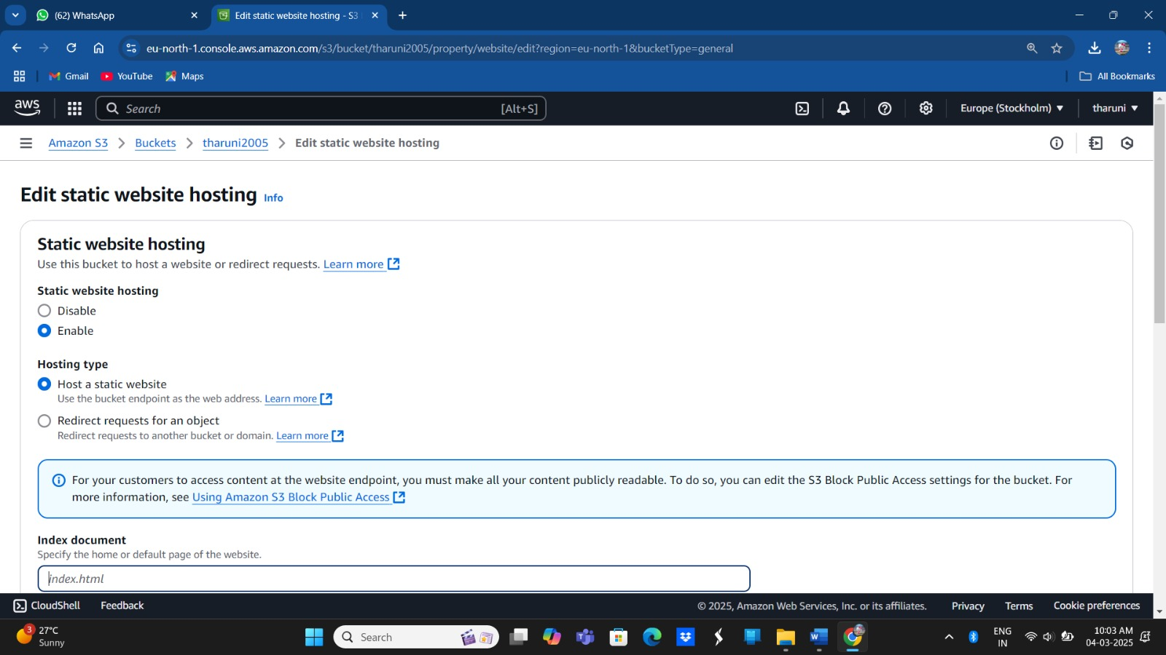
Step-6: Edit static website hosting

Slide 11
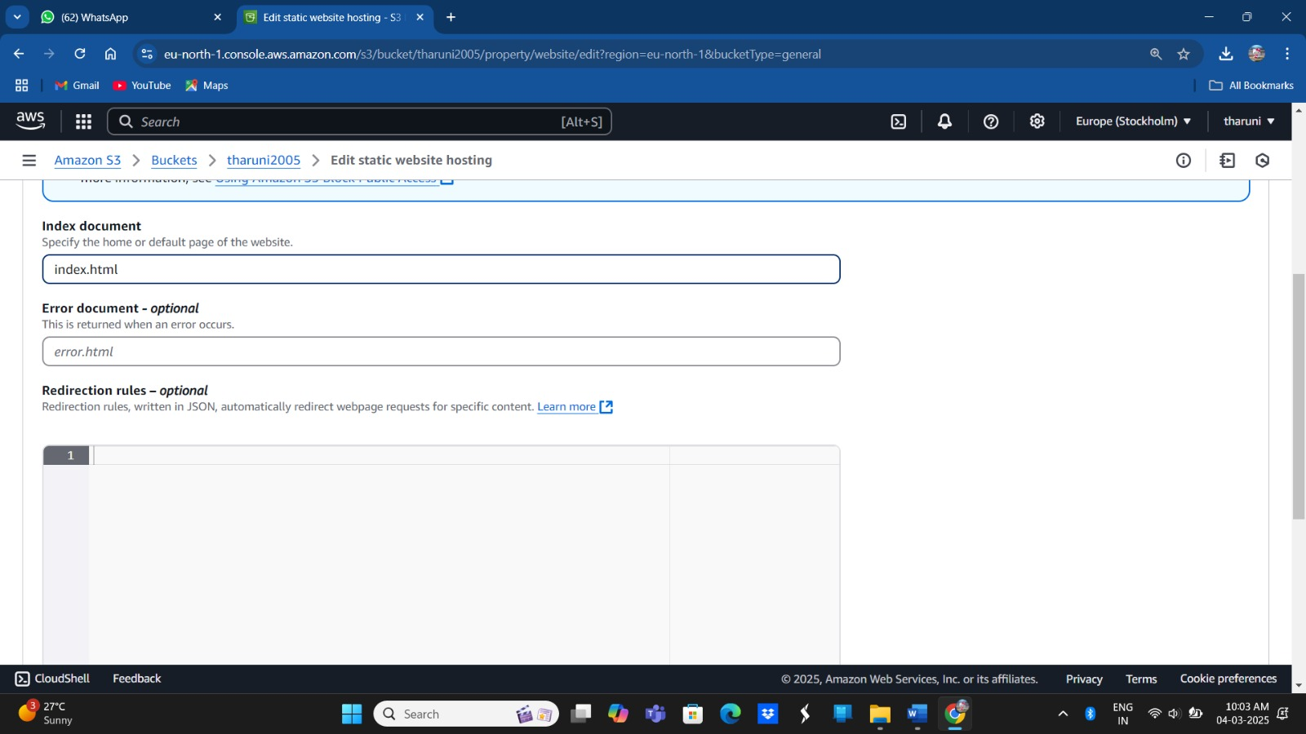
Click on Save Changes in below figure:

Slide 12
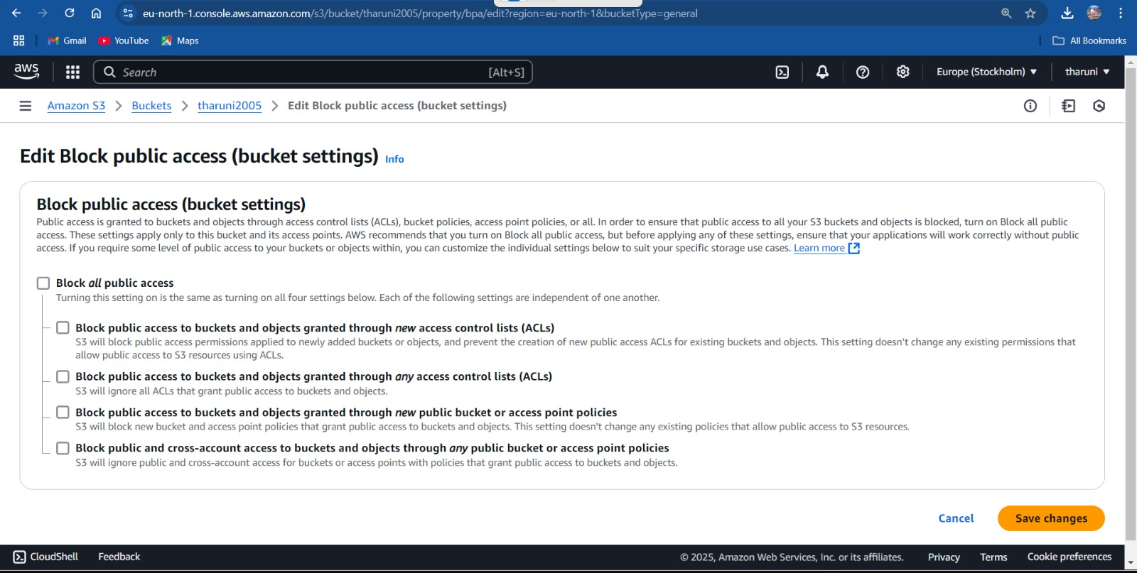
Step-7:Edit Block Public Access(bucket settings)
Then click Save Changes:

Slide 13
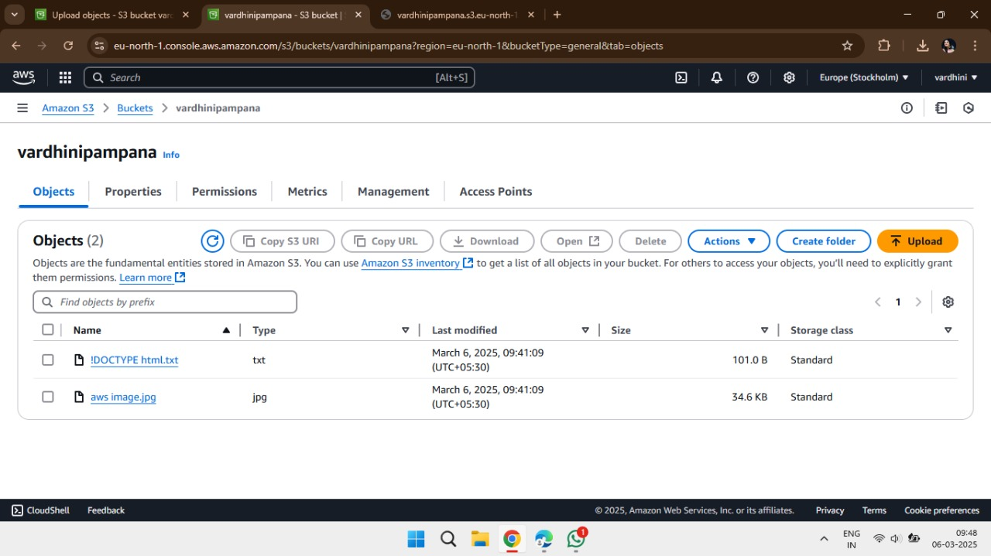
Step-8:Then click on created Bucket that displays permissions to
deploy static website

Slide 14
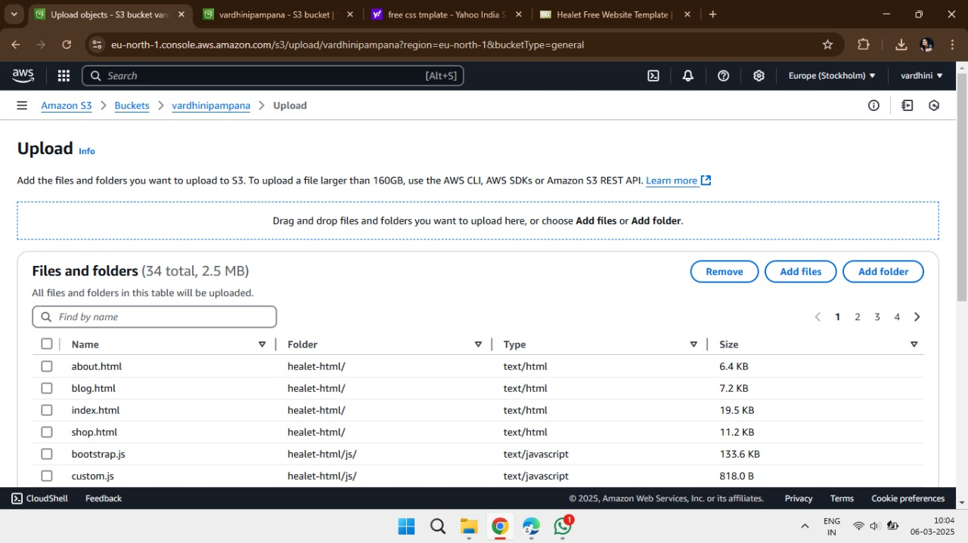
Step-9: Then Click on Upload& Add file /folder

Slide 15
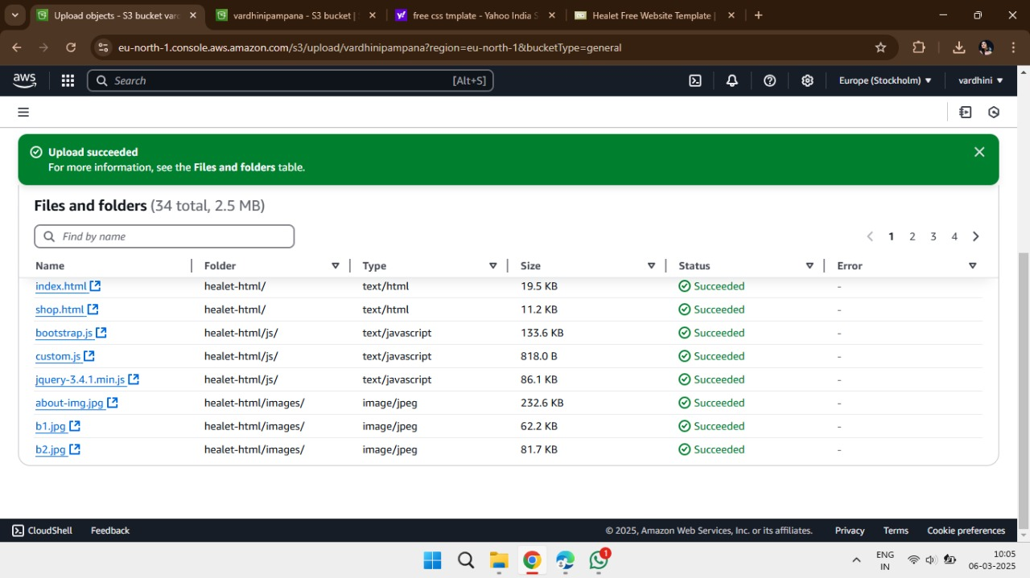
Step-10: File uploaded Successfully

Slide 16
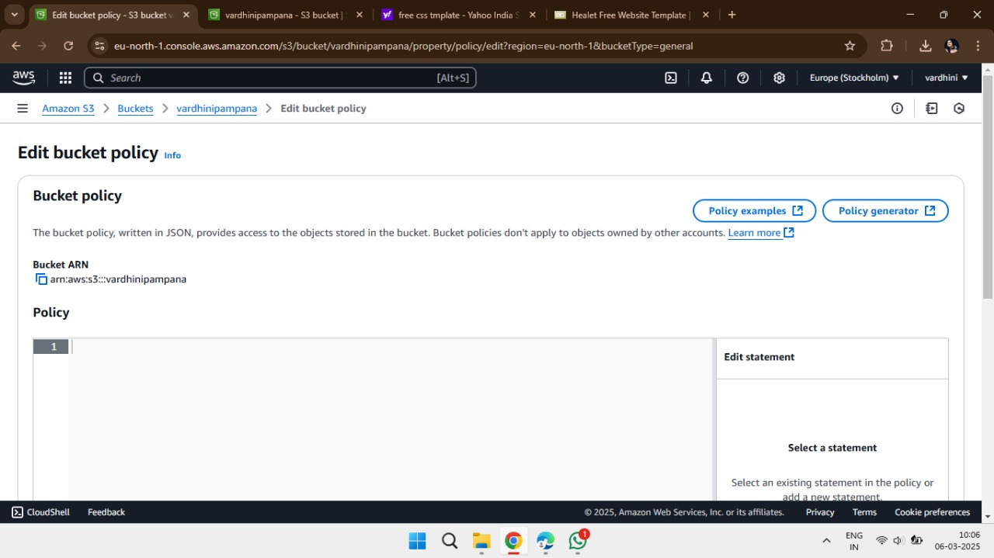
Step-11: Edit Bucket Policies& click on Bucket ARN and Copy path.
URL:Arn:aws:s3::::vardhinipampana

Slide 17
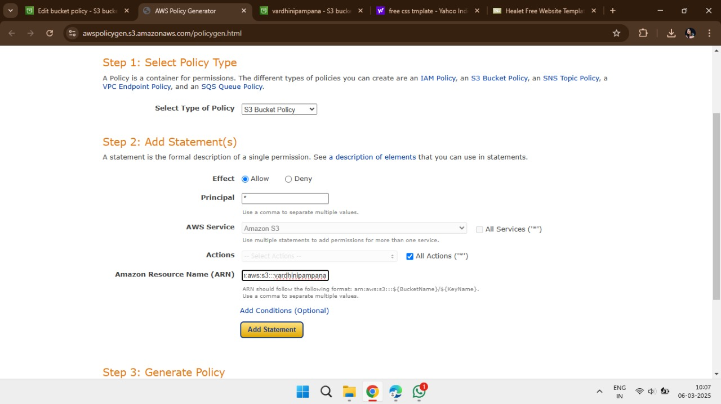
Step-12: While click on path it gives some type of policies
to be entered

Slide 18
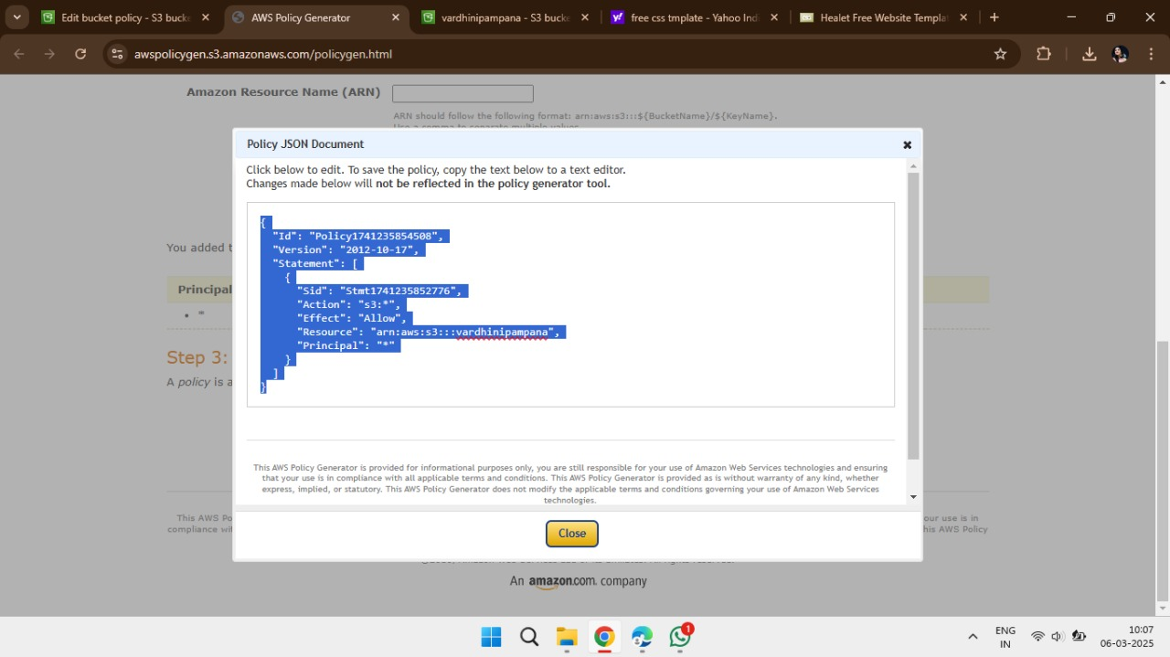
Step-13: Then click on add statement it shows json
document and provide code

Slide 19
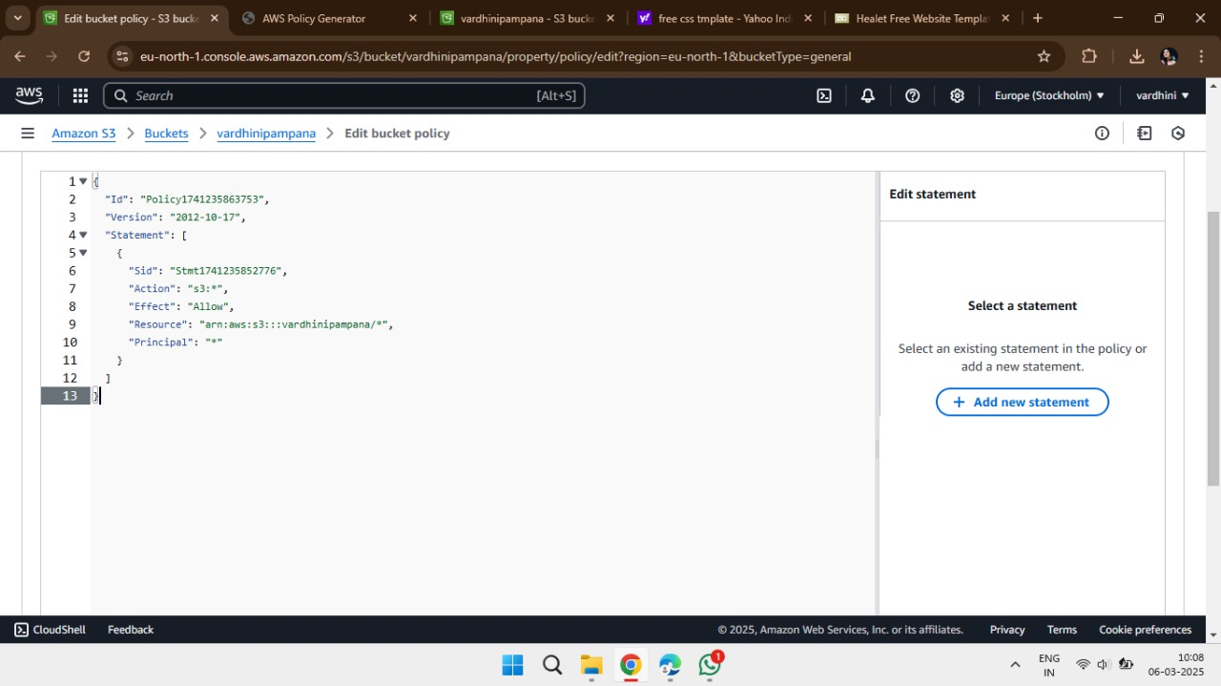
Step-13: Select the code and paste it on edit bucket policies

Slide 20
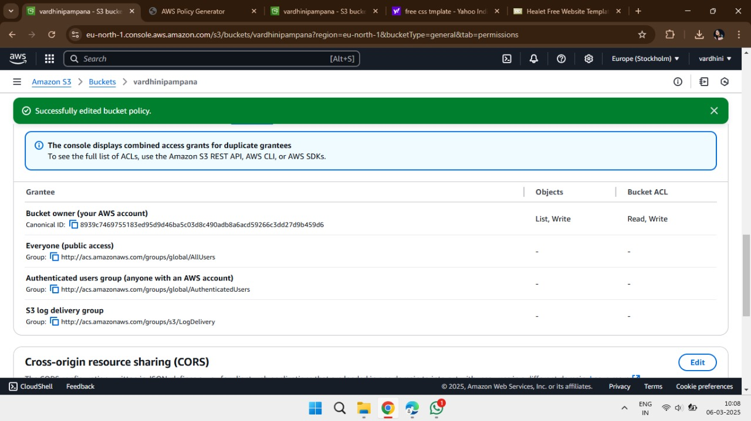
Step-14:Successfully edited the bucket policies

Slide 21

Step-15:Select the URL path
URL:prasanth.s3-website.eu-north-1amazonaws.com/healet-html/

